Slide 1
Data Analysis Project [UC Berkeley Data Analytics Bootcamp] Apr 03, 2019
Kevin Zhao, Steven Kelso, Tim Ryan, Aarti Mathur

Slide 2
Key Questions
Did the number of incidents of 'petty theft’ increase, when in 2010 Penal Code § 487 was amended to increase the amount of property fitting the definition of petty theft from $400 to $950 ?
Source news article: https://www.greghillassociates.com/new-petty-theft-limit-changes-some-grand-theft-convictions.html
Did the number of incidents change in any one particular neighborhood more than the others, or did the trend change consistently across all neighborhoods in the city?
Is there a correlation between the demographic profile of the neighborhood and the number of incidents?
Are the trends in SF in line with the general trends in other cities, such as Chicago, that were not affected by the amendment to the CA law?

Slide 3




Project analysis slide 2
Data & Methodology
https://datasf.org/
“Police Department Incident Reports: Historical 2003 to May 2018”
Google Maps Locations API
https://console.cloud.google.com/apis/library/maps-backend.googleapis.com
Chicago Data Portal
https://data.cityofchicago.org/Public-Safety/Crimes-2001-to-present-Dashboard/5cd6-ry5g

Slide 4
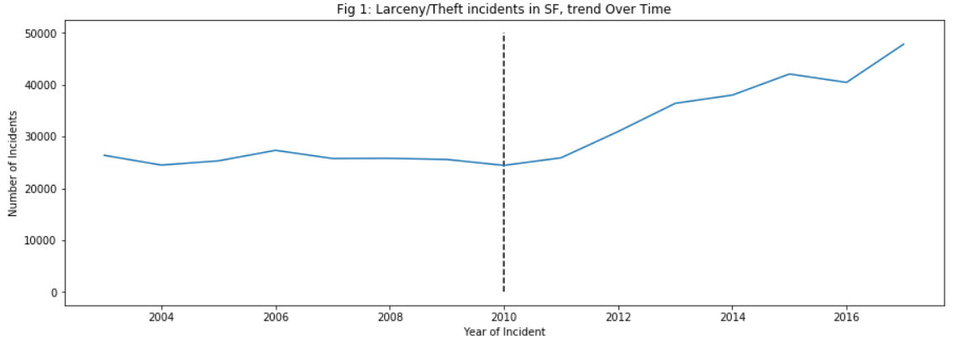
Project analysis slide 5
Before and After
Incidents of Larceny/Theft went up 21% in the three year period after 2010
2007 – 2009
Total Thefts:
2010
Penal Code § 487 Amended
2011 – 2014
Total Thefts:
77,162
93,293

Slide 5
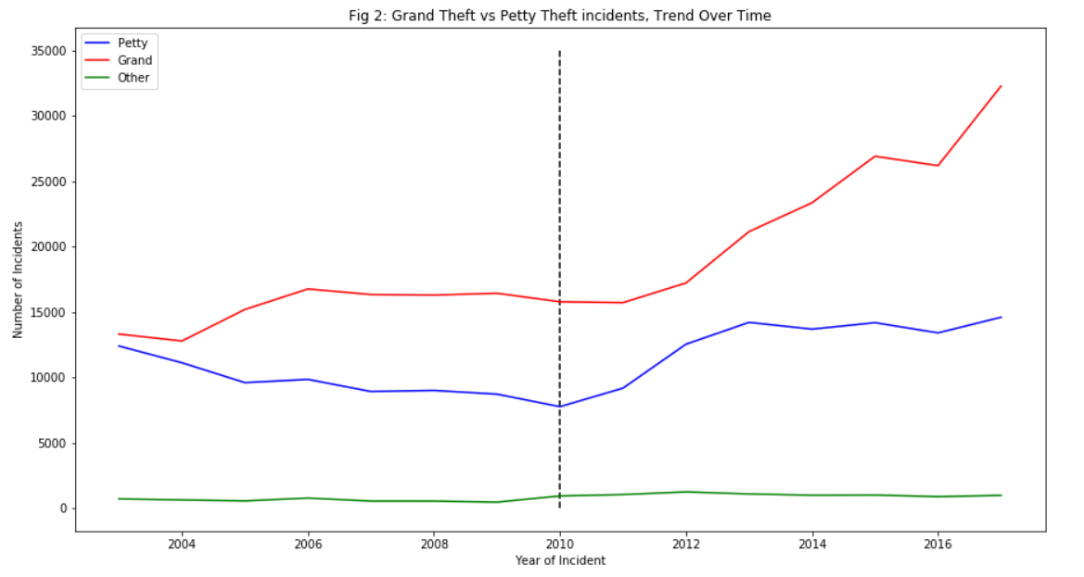
Project analysis slide 5
Petty Theft vs Grand Theft
Incidents of Petty Theft went up 35% in the three year period after 2010 vs three year before
2011 – 2014
Petty Theft: 35,895 (38.5%)
Grand Theft: 54,057 (58%)
Other: 3341 (3.5%)
2007 – 2009
Petty Theft: 26,612 (34.5%)
Grand Theft: 49,036 (63.5%)
Other: 1514 (2%)

Slide 6
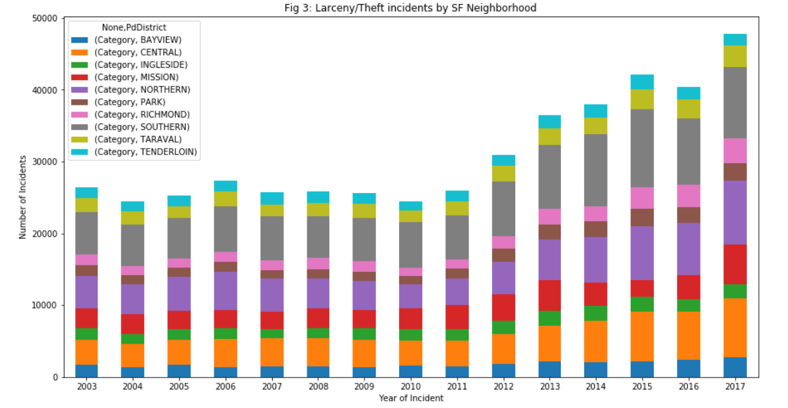
Project analysis slide 5
Incidents by Neighborhood
Southern police district reports the highest number of incidents every year

Slide 7
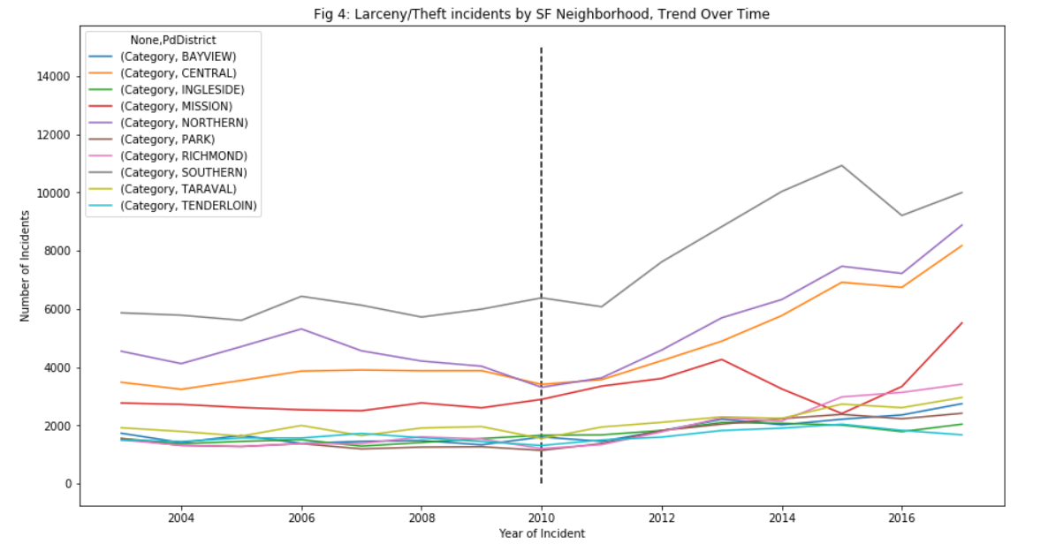
Project analysis slide 5
Incidents by Neighborhood
Southern police district saw a slight decline in incidents in 2010

Slide 8
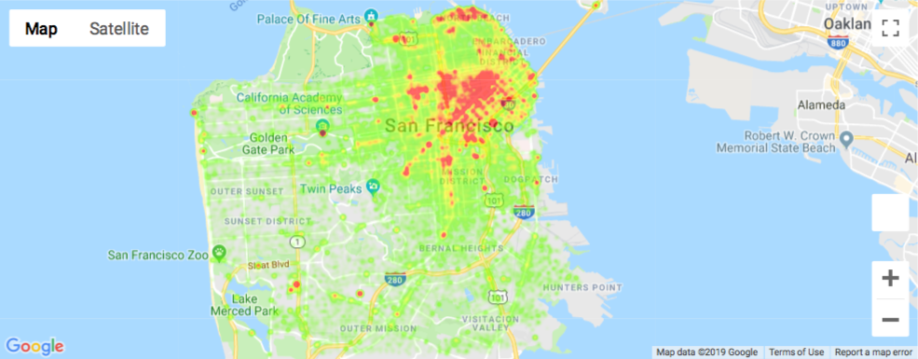
Project analysis slide 5
Incidents by Neighborhood Heatmap

Slide 9
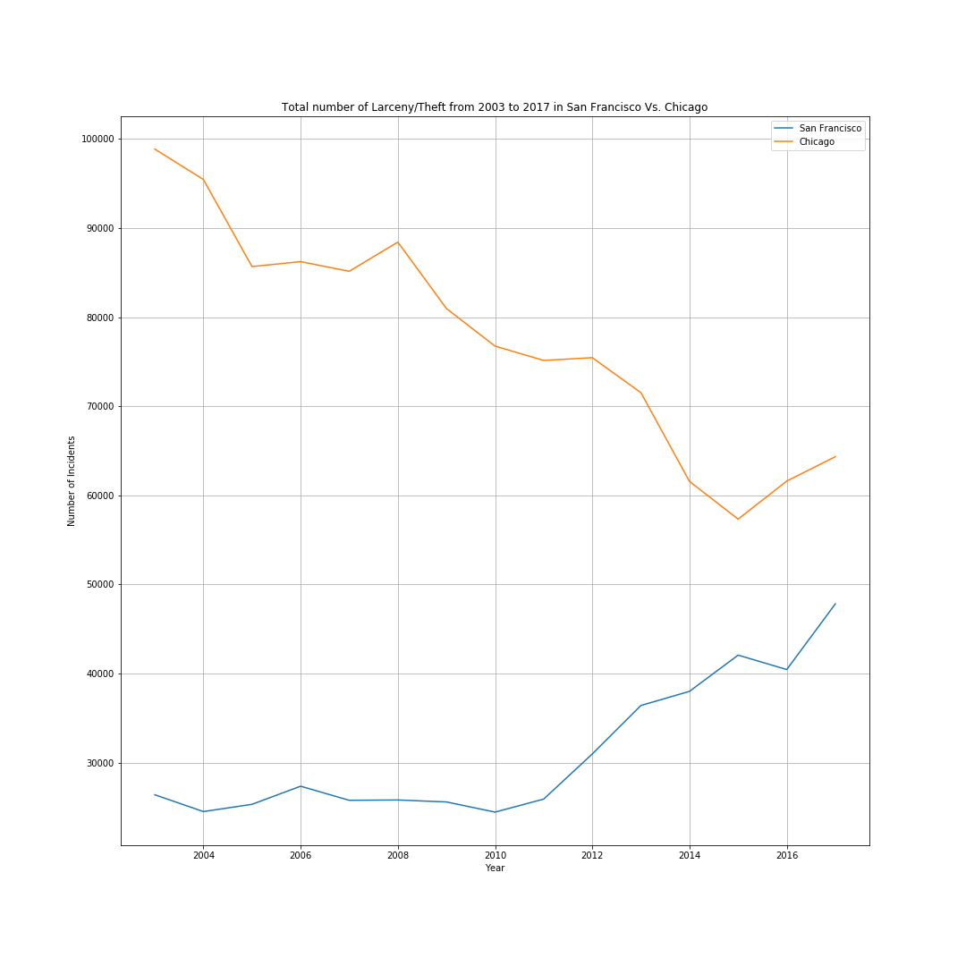
SF vs Chicago

Slide 10
Project analysis slide 10
Project Analysis
Following the change to Penal Code § 487 in 2010 , there is a marked and sustained increase in the total number of theft incidents across San Francisco
21% increase in total incidents in 3 years following amendment versus 3 years prior
Incidents of petty theft DID increase more than incidents of grand theft, both in absolute number of incidents and by proportion of total theft crimes
34.5% of total pre-2010 vs. 38.5% of total post-2010
Most theft incidents are concentrated in the Central Business Districts of San Francisco, as opposed to the districts that are primarily residential. This trend remained the same despite the overall increase in theft crimes across the city
When compared to the trend in Chicago, it is clear that overall theft incidents begin to sharply increase in San Francisco after 2010, while Chicago maintained its downward trend of decreasing theft incidents across the city that began before and continued after 2010

Slide 11
Thank You

